Slide 1
Business Case 3
Detecting abnormal markets: Early Warning Systems
Raffaella D'Anna
Alessandro Del Vitto
Michele Di Sabato
Rita Numeroli
Andrea Puricelli

Slide 2
SOLUTION APPROACH Three different methods:
1) Anomaly Detection
2) Supervised Classification
3) Unsupervised Clustering

Slide 3
1) Anomaly Detection
Feature Selection a) Mean comparison b) Statistical test c) Financial Meaning
Correlation Structure a) Gaussian Copula b) t - Copula

Slide 4
Anomaly Detection: Mean Comparison
For each feature we compute:
Average during risk-off period
-
Average during risk-on period
abs
If it is greater than a threshold, then we consider the feature as relevant.

Slide 5
Anomaly Detection: Mean Comparison
Performance Index | Score
Precision | 0.4361
Recall | 0.9638
F1 | 0.6005

Slide 6
Anomaly Detection: Relevant Financial Indices
Our selection of indexes:
XAUBGNL -> Gold Spot
BCSURP2R -> Economic surprise index
VIX -> Volatility Index
GT10 -> US Govt Bond 10 Yr
USGG2Y -> US Govt Bond 2 Yr
USGG3M -> US Govt Bond 3 Mth
EONIA -> Euro Over Night Index Avg
LUACTRUU -> Corporate Bond Index
LF98TRW -> High Yield Bond Index
MSCI USA -> USA stock mkt
MSCI EUROPE -> EU stock mkt
MSCI CINA -> Cinese stock mkt
GT1TL2YR -> italian BTP
Performance Index | Score
Precision | 0.4405
Recall | 0.9928
F1 | 0.6102

Slide 7
Nonparametric Permutational Test
Let X0 and X1 be the feature values during a risk-on and risk-off period respectively. Let diffQ05, diffQ20, diffQ50, diffQ75 and diffQ90 denote the difference in absolute value between the quantiles of X0 and X1 of order 0.05, 0.20, 0.50, 0.75, 0.90. Define n0 = length(X0).
Permute the pooled dataset X_pooled = [X0; X1].
Compute X0_perm = X_pooled[1:n0,:] and X1_perm = X_pooled[n0+1,end,:]
Compute the new absolute differences between quantiles of X0_perm and X1_perm.
Define the pvalue of the test as the normalized number of times (out of 100000) in which the absolute differences of the permuted quantiles are greater than the absolute differences of the quantiles of the original dataset
Repeat 100000 times

Slide 8
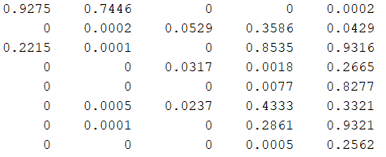
A slice of the pvalue matrix
5 (number of quantiles)
.
.
.
Total number of features
.
.
.

Slide 9
Anomaly Detection: Statistically Relevant Features
Performance Index | Score
Precision | 0.4369
Recall | 0.9783
F1 | 0.6040

Slide 10
2) Supervised Classification
Logistic Regression Model
Naïve Bayes Classifier
Random Forests
Artificial Neural Networks Models
PROBLEM : UNBALANCED DATASET

Slide 11
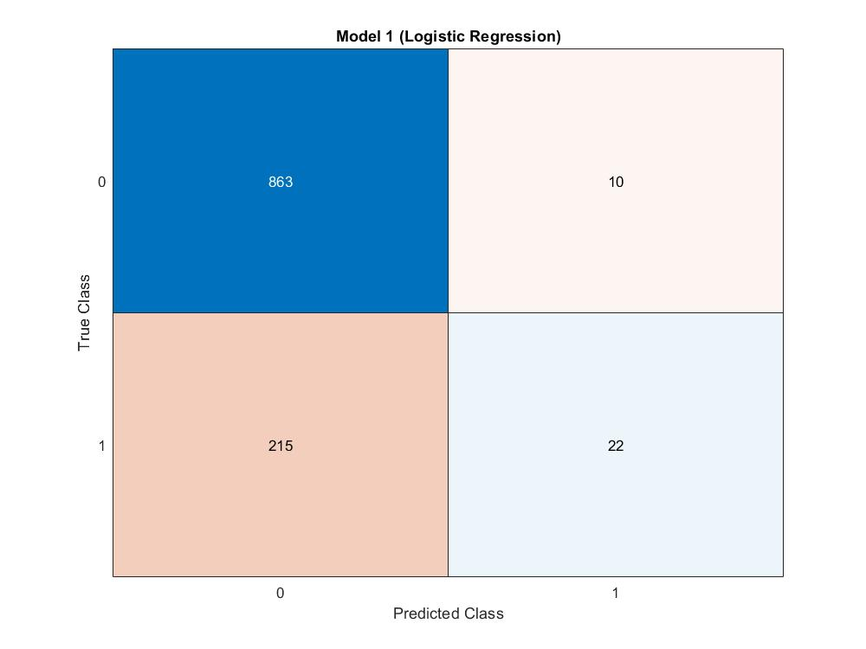
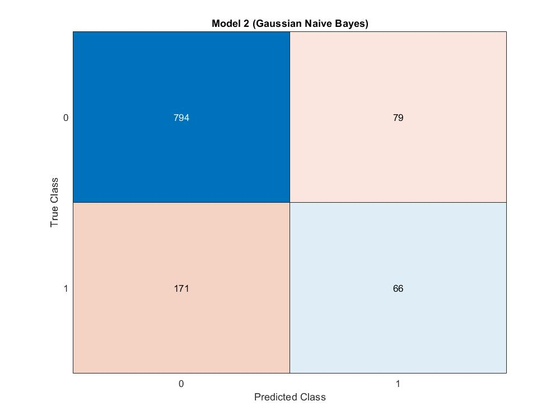


2) Supervised Classification
1) Logistic Regression Model
2) Gaussian Naive Bayes

Slide 12
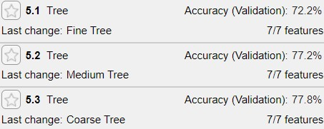
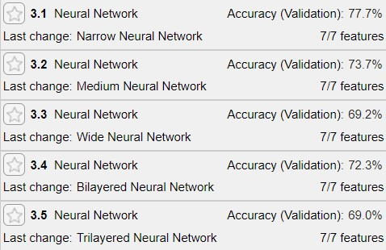
2) Supervised Classification
3) Random Forest
4) Artificial Neural Networks

